Slide 1


CE251: PROGRAMMING IN JAVA
July – November 2020-21
OOPs Abstraction
Prof. Rima Patel
Assistant Professor

Slide 2

So far we have covered
Class
Object
Inheritance
Polymorphism
OOPS Abstratcion

Slide 3
What is abstraction in Java?
Abstraction is a process of hiding the implementation details and showing only functionality to the user.
Hiding the process, highlighting set of services
OOPS Abstratcion

Slide 4
Any real time example of abstraction?
Bank ATM
OOPS Abstratcion

Slide 5
What is the difference between Abstraction & Encapsulation?
OOPS Abstratcion

Slide 6
Abstraction lets you focus on what the object does instead of how it does, while Encapsulation means hiding the internal details of how an object works. ...
Abstraction hides unwanted data and provides the relevant data.
In Java, Abstraction is supported using interface andabstract class while Encapsulation is supported using access modifiers e.g. public, private and protected.
OOPS Abstratcion

Slide 7
How many ways to achieve abstraction?
There are two ways to achieve abstraction in java
Abstract class (0 to 100%)
Interface (100%)
OOPS Abstratcion

Slide 8
Abstract class
A class that is declared with abstract keyword, is known as abstract class in java.
It can have abstract and non-abstract methods (method with body).
OOPS Abstratcion

Slide 9
We will discuss all 5 element for abstract class
Instance variable possible
Method can be abstract
Constructor is possible for abstract class
Instance block is also possible
Static block is possible too
OOPS Abstratcion

Slide 10
Interview questions?
What is the need of abstract class?
How to prevent the object creation in java?
To prevent object creation
OOPS Abstratcion

Slide 11
The purpose of an abstract class is to define some common behavior that can be inherited by multiple subclasses, without implementing the entire class.
OOPS Abstratcion

Slide 12
1. Abstract class instance variable We will discuss it with the abstract class constructor
OOPS Abstratcion

Slide 13
2. Abstract class method
OOPS Abstratcion

Slide 14
//Abstract class
abstract class A{}
//Abstract method
abstract void printStatus();
OOPS Abstratcion

Slide 15
How normal method different from abstract method?
Abstract method contain only method declaration
Abstract method end with semicolon
To represent abstract method use abstract keyword
OOPS Abstratcion

Slide 16
If class contain at least one abstract method then class called abstract class
class Test
{
void m1() { }
abstract void m2();
}
abstract class Test
{
void m1() { }
abstract void m2();
}
OOPS Abstratcion

Slide 17
What is the difference between normal class & abstract class?
It is not possible to create an object of abstract class but we can create an object for normal class.
This is not a complete definition of abstract class.
OOPS Abstratcion

Slide 18
Example
abstract class Test
{
void m1() { }
abstract void m2();
}
abstract class Test
{
void m1() { }
void m2(){ }
}
OOPS Abstratcion

Slide 19
Complete definition of abstract class
Abstract class may contain abstract method
Abstract class may not contain abstract method
It is not possible to create abstract class object
OOPS Abstratcion

Slide 20
Example-1
abstract class Parent
{
abstract void m1();
abstract void m2();
void m3()
{ S.O.P.(“m3 method”);
}
}
NO
class Child extends Parent
{
void m1()
{ S.O.P.(“m1 method”);}
void m2()
{ S.O.P.(“m2 method”);}
P.S.V.M()
{
Parent p = new Parent();
Child c = new Child();
}
}
Will it compile successfully?
OOPS Abstratcion

Slide 21
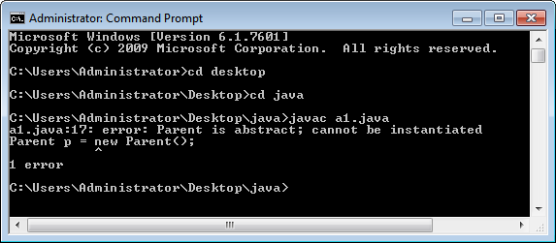
OOPS Abstratcion

Slide 22
Example-2
abstract class Parent
{
abstract void m1();
abstract void m2();
void m3()
{ S.O.P.(“m3 method”);
}
}
Yes
class Child extends Parent
{
void m1()
{ S.O.P.(“m1 method”);}
void m2()
{ S.O.P.(“m2 method”);}
P.S.V.M()
{
Parent p = new Child();
p.m1(); p.m2(); p.m3();
}
}
Will it compile successfully?
OOPS Abstratcion

Slide 23
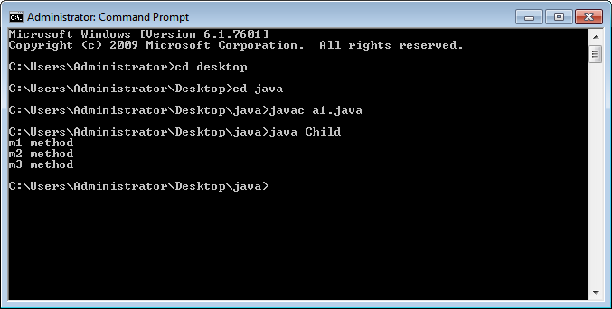
OOPS Abstratcion

Slide 24
Example-3
class C extends B
{
void m2()
{ S.O.P.(“m2 method”);}
}
abstract class A
{
abstract void m1();
abstract void m2();
abstract void m3();
}
class D extends C
{
void m3()
{ S.O.P.(“m3 method”);}
P.S.V.M()
{
D d = new D();
d.m1(); d.m2(); d.m3();
}
class B extends A
{
void m1()
{ S.O.P.(“m1 method”);}
}
NO
Will it compile successfully?
OOPS Abstratcion

Slide 25
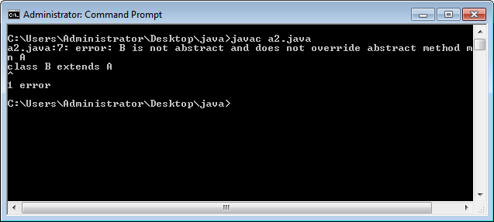
OOPS Abstratcion

Slide 26
What changes we required to make previous code executable?
Declare class as abstract class
Why?
To use an abstract class, you have to inherit it from another class, provide implementations to the abstract methods in it.
If you inherit an abstract class, you have to provide implementations to all the abstract methods in it.
OOPS Abstratcion

Slide 27
Example-3
abstract class C extends B
{
void m2()
{ S.O.P.(“m2 method”);}
}
abstract class A
{
abstract void m1();
abstract void m2();
abstract void m3();
}
class D extends C
{
void m3()
{ S.O.P.(“m3 method”);}
P.S.V.M()
{
D d = new D();
d.m1(); d.m2(); d.m3();
}
abstract class B extends A
{
void m1()
{ S.O.P.(“m1 method”);}
}
Will it compile successfully?
YES
OOPS Abstratcion

Slide 28
Is it possible to declare main method in abstract class?
abstract class Test
{
P.S.V.M()
{
S.O.P(“Hello abstract class”);
}
}
Compile & run successfully
OOPS Abstratcion

Slide 29
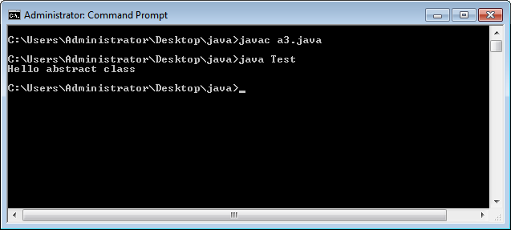
OOPS Abstratcion

Slide 30
Can abstract class have constructor?
3.
Abstract class constructor
OOPS Abstratcion

Slide 31
Inside the abstract class, constructor declaration is possible or not?
abstract class Test
{
Test()
{
}
P.S.V.M()
{
S.O.P(“Hello abstract class”);
}
}
Its possible
OOPS Abstratcion

Slide 32
abstract class Test
{
Test()
{
System.out.println("abstarct class constructor");
}
public static void main(String args[])
{
System.out.println("Hello abstract class");
}
}
Polymorphism

Slide 33
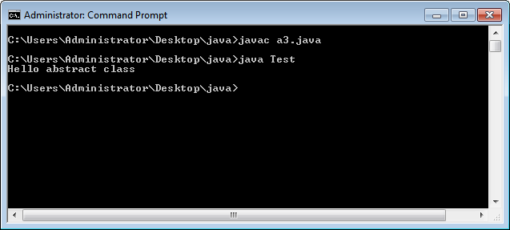
OOPS Abstratcion

Slide 34
Inside the abstract class, constructor declaration is possible or not?
abstract class Test
{
Test()
{
System.out.println("abstarct class constructor");
}
public static void main(String args[])
{
Teat t=new Test();
System.out.println("Hello abstract class");
}
}
It will generate an error- object creation is not allowed
OOPS Abstratcion

Slide 35
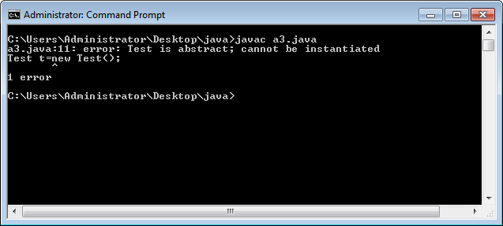
OOPS Abstratcion

Slide 36
How to execute the abstract class constructor without object creation?
class Test1 extends Test
{
void m1()
{
S.O.P.(“m1 method”);
}
Test1()
{
super();
S.O.P.(“currentclass constructor”);
}
P.S.V.M()
{
Test1 t = new Test1();
t.m1();
}
}
abstract class Test
{
Test()
{ S.O.P.(“abstract class constructor”);
}
abstract void m1();
}
OOPS Abstratcion

Slide 37
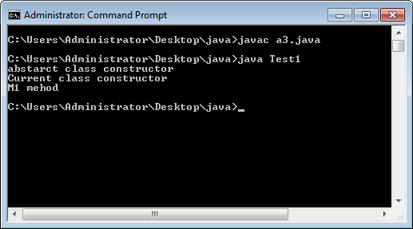
OOPS Abstratcion

Slide 38
Conclusion
For abstract class constructor declaration is allowed & possible to execute constructor also
OOPS Abstratcion

Slide 39
Abstract class instance variable example
abstract class Parent
{
int x;
Parent(int x)
{ this.x=x;
}
abstract void details();
}
class Child extends Parent
{
int y;
Child(int x, int y)
{
super(x);
this.y=y;
}
void details()
{
S.O.P.(“Parent x: ” + super.x);
S.O.P.(“Child y: ” + this.y);
}
}
class Test{
P.S.V.M()
{
Child c = new Child(10,20);
c.details();
}}
OOPS Abstratcion

Slide 40
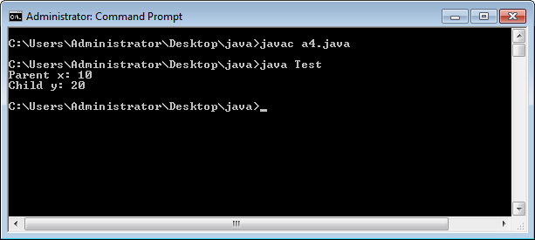
OOPS Abstratcion

Slide 41
4. Instance & static block for abstract class
OOPS Abstratcion

Slide 42
Example
abstract class Test
{
{
S.O.P.(“abstract class instance block”);
}
static
{
S.O.P.(“abstract static block”);
}
}
class Test1 extends Test
{
P.S.V.M()
{
Test1 t = new Test1();
}
}
Compile & execute successfully
OOPS Abstratcion

Slide 43
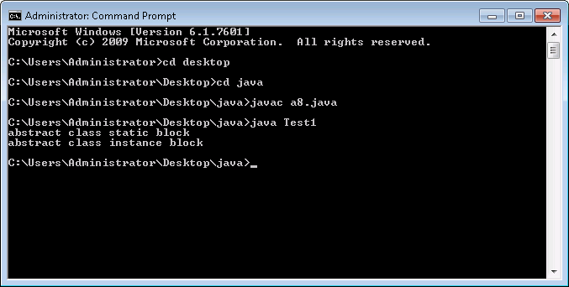
OOPS Abstratcion

Slide 44
Can we inherit abstract class to another abstract class?
one abstract class extends another abstract class
Yes you can
OOPS Abstratcion

Slide 45
Example
abstract class One {
}
abstract class Two extends One {
}
OOPS Abstratcion

Slide 46
Duplicate abstract method Example
abstract class One {
abstract void m1();
void m1(){
System.out.println("non abstract method" );
} }
Error-
method m1() is already defined in class One
public class MyClass extends One {
void m1()
{ System.out.println("abstract class method" );
}
public static void main(String args[]) { System.out.println("My class");
MyClass m = new MyClass();
m.m1();
}}
Will it compile or not?
OOPS Abstratcion

Slide 47
What is the output here
abstract class Bike{
abstract void run();
}
class Honda extends Bike{
void run()
{
System.out.println("running safely..");
}
public static void main(String args[]){
Bike obj = new Honda(); // is there any error here
obj.run();
}
}
No error
Execute successfully
OOPS Abstratcion

Slide 48
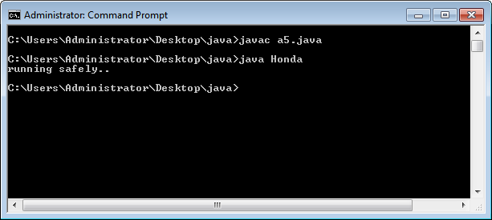
OOPS Abstratcion

Slide 49
What is the output here
abstract class Bank{
abstract int getRateOfInterest();
}
class SBI extends Bank{
int getRateOfInterest(){return 7;}
}
class PNB extends Bank{
int getRateOfInterest(){return 8;}
}
class TestBank{
public static void main(String args[]){
Bank b;
b=new SBI();
System.out.println("Rate of Interest is: "+b.getRateOfInterest()+" %");
b=new PNB();
System.out.println("Rate of Interest is: "+b.getRateOfInterest()+" %");
}}
OOPS Abstratcion

Slide 50
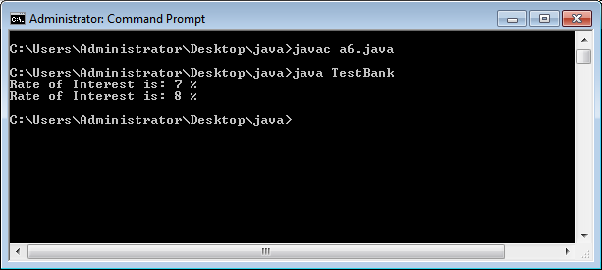
OOPS Abstratcion

Slide 51
What is the output here
abstract class Bike{
Bike() { System.out.println("bike is created");}
abstract void run();
void changeGear() { System.out.println("gear changed");}
}
class Honda extends Bike{
void run() { System.out.println("running safely..");}
}
class TestAbstraction{
public static void main(String args[]){
Bike obj = new Honda();
obj.run();
obj.changeGear(); // is it work here?
}
}
YES
OOPS Abstratcion

Slide 52
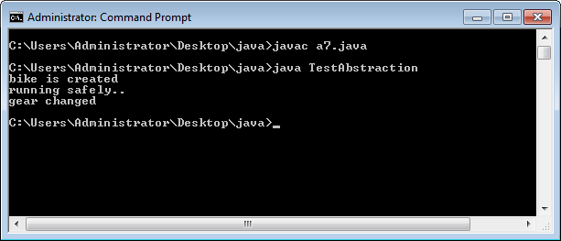
OOPS Abstratcion

Slide 53
Very Important concept
make an array of the abstract class
public abstract class Game{
...
}
Game games = new Game(); //Error
Game[] gamesArray = new Game[10]; //No Error
OOPS Abstratcion

Slide 54
Conclusion
Instantiation means creation of an instance of a class.
Game[] gamesArray = new Game[10];
In this scenario, you've just declared a gamesArray of type Game with the size 10(just the references and nothing else). That's why its not throwing any error.
OOPS Abstratcion

Slide 55
What is Interface in java?
The interface in java is a mechanism to achieve abstraction. There can be only abstract methods in the java interface not method body. It is used to achieve abstraction and multiple inheritance in Java.
Java Interface also represents IS-A relationship.
It cannot be instantiated just like abstract class.
Interface is also known as 100% pure abstract class
OOPS Abstratcion

Slide 56
What is the purpose of Interface?
It is used to achieve abstraction.
By interface, we can support the functionality of multiple inheritance.
To provide loose coupling
OOPS Abstratcion

Slide 57
How to declare interface
An interface is declared by using the interface keyword.
It provides total abstraction; means all the methods in an interface are declared with the empty body, and all the fields are public, static and final by default.
A class that implements an interface must implement all the methods declared in the interface.
OOPS Abstratcion

Slide 58
How do we use interface in program?
interface Player
{
int id = 10;
int move();
}
OOPS Abstratcion

Slide 59
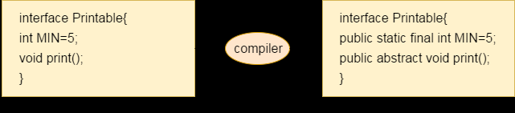
What is the conclusion here?
Interface are by default abstract
Variables are by default public, static & final
Methods are by default public & abstract
OOPS Abstratcion

Slide 60
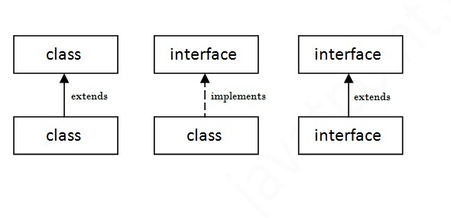
How to create relationship between classes and interfaces?
OOPS Abstratcion

Slide 61
Example1
interface printable{
void print();
}
class A6 implements printable{
public void print(){System.out.println("Hello");}
public static void main(String args[]){
A6 obj = new A6();
obj.print();
}
}
Polymorphism

Slide 62
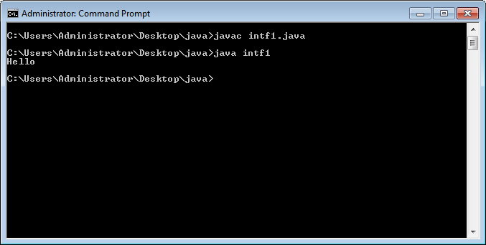
OOPS Abstratcion

Slide 63
Will it compile or not?
Interface Test{
void m1();
void m2();
void m3();
}
Class intf2 implements Test{
void m1(){ S.O.P.(“M1 method”);}
void m2(){ S.O.P.(“M2 method”);}
void m3(){ S.O.P.(“M3 method”);}
P.S.V.M(String[] args){
Test1 t = new Test1();
t.m1();
t.m2();
t.m3();
}}
Compiler error:
Permission reduce
Solution
public void m1()
{
}
Polymorphism

Slide 64
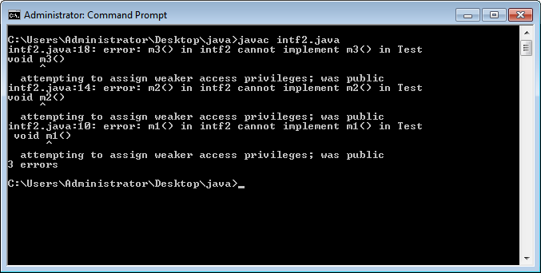
OOPS Abstratcion

Slide 65
Will it compile or not?
Interface Test{
void m1();
void m2();
void m3();
}
Class intf2 implements Test{
public void m1(){ S.O.P.(“M1 method”);}
public void m2(){ S.O.P.(“M2 method”);}
public void m3(){ S.O.P.(“M3 method”);}
P.S.V.M(String[] args){
Test1 t = new Test1();
t.m1();
t.m2();
t.m3();
}}
OOPS Abstratcion

Slide 66
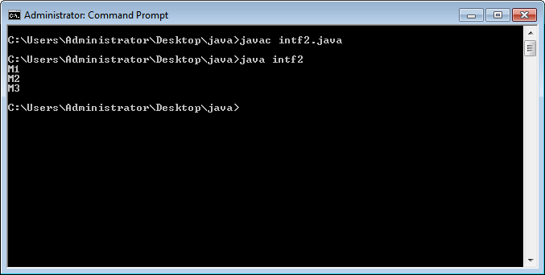
OOPS Abstratcion

Slide 67
Will it compile or not?
Interface Item{
void m1();
void m2();
void m3();
}
class Test1 implements Item{
void m1() { S.O.P.(“M1 method”);}
}
class Test2 extends Test2{
void m2() { S.O.P.(“M2 method”);}
}
class Test3 extends Test2{
void m3() { S.O.P.(“M3 method”);}
P.S.V.M(String[] args){
Test3 t = new Test3();
t.m1();
t.m2();
t.m3();
}}
Compiler error:
Solution-
Declare class as
abstract class
OOPS Abstratcion

Slide 68
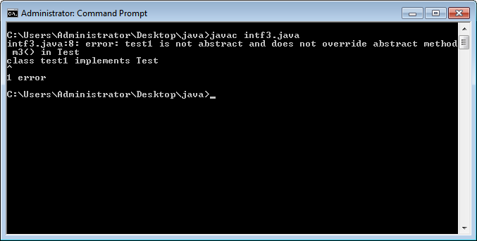
OOPS Abstratcion

Slide 69

Polymorphism

Slide 70
What is the output here?
interface printable{
void print();
}
class CEIT implements printable{
public void print(){
System.out.println("Hello Interface");
}
public static void main(String args[]){
CEIT obj = new CEIT();
obj.print();
}
}
OOPS Abstratcion

Slide 71
What is the output here?
interface Bank{
float rateOfInterest();
}
class SBI implements Bank{
public float rateOfInterest(){ return 9.15f;}
}
class PNB implements Bank{
public float rateOfInterest(){ return 9.7f;}
}
class TestInterface{
public static void main(String[] args){
Bank b=new SBI();
System.out.println("ROI: "+b.rateOfInterest());
}}
YES
OOPS Abstratcion

Slide 72
//Interface declaration: by first user
interface Drawable{
void draw();
}
//Implementation: by second user
class Rectangle implements Drawable{
public void draw(){System.out.println("drawing rectangle");}
}
class Circle implements Drawable{
public void draw(){System.out.println("drawing circle");}
}
//Using interface: by third user
class TestInterface{
public static void main(String args[]){
Drawable d=new Circle();
d.draw();
}}
OOPS Abstratcion

Slide 73
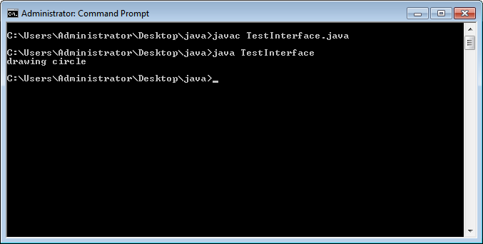
OOPS Abstratcion

Slide 74
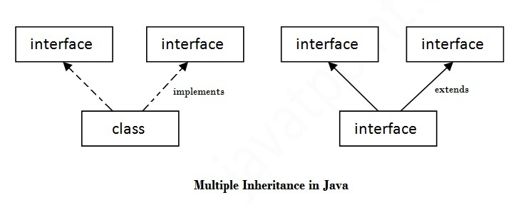
How to achieve Multiple inheritance in Java by interface?
OOPS Abstratcion

Slide 75
What is the output here?
interface Printable{
void print();
}
interface Showable{
void show();
}
class A7 implements Printable,Showable{
public void print(){System.out.println("Hello");}
public void show(){System.out.println("Welcome");}
public static void main(String args[]){
A7 obj = new A7();
obj.print();
obj.show();
}
}
OOPS Abstratcion

Slide 76
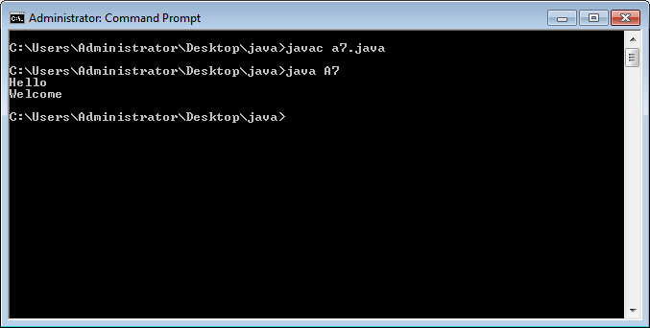
OOPS Abstratcion

Slide 77
Will it compile or not?
interface Printable{
void print();
}
interface Showable{
void print();
}
class TestMultiInterface implements Printable, Showable{
public void print(){System.out.println("Hello");}
public static void main(String args[]){
TestMultiInterface obj = new TestMultiInterface();
obj.print();
} }
OOPS Abstratcion

Slide 78
Is there any ambiguity in previous code?
Printable and Showable interface have same methods but its implementation is provided by class TestMultiInterface, so there is
no ambiguity.
OOPS Abstratcion

Slide 79
Multiple inheritance is not supported through class in java, but it is possible by an interface, why?
multiple inheritance is not supported in the case of class because of ambiguity. However, it is supported in case of an interface because there is no ambiguity. It is because its implementation is provided by the implementation class
Polymorphism

Slide 80
Can we inherit interface?
one interface extends another interface
YES
OOPS Abstratcion

Slide 81
Example
interface Printable{
void print();
}
interface Showable extends Printable{
void show();
}
class ExtendInterface implements Showable{
public void print(){ System.out.println("Hello");}
public void show(){ System.out.println("Welcome");}
public static void main(String args[]){
ExtendInterface obj = new ExtendInterface();
obj.print();
obj.show();
} }
OOPS Abstratcion

Slide 82

OOPS Abstratcion

Slide 83
Java 8: Default Method in Interface
Since Java 8, we can have method body in interface. But we need to make it default method.
OOPS Abstratcion

Slide 84
Example
interface Drawable{
void draw();
default void msg(){System.out.println("default method");}
}
class Rectangle implements Drawable{
public void draw(){System.out.println("drawing rectangle");}
}
class TestInterfaceDefault{
public static void main(String args[]){
//Drawable d=new Rectangle();
//d.draw();
//d.msg();
Rectangle r=new Rectangle();
// Rectangle r=new Drawable();
r.draw();
r.msg();
}}
OOPS Abstratcion

Slide 85
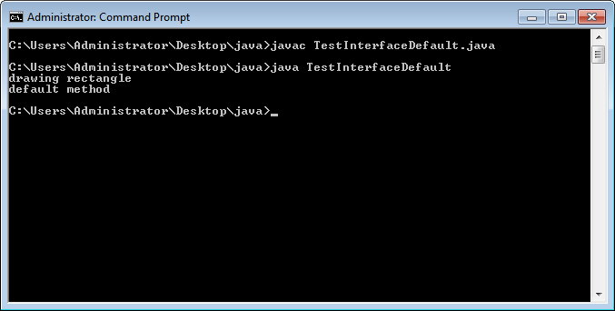
OOPS Abstratcion

Slide 86
The reason we have default methods in interfaces is to allow the developers to add new methods to the interfaces without affecting the classes that implements these interfaces.
OOPS Abstratcion

Slide 87
Java 8: Static Method in Interface
These static method will act as helper methods.
These methods are the parts of interface not belongs to implementation class objects.
OOPS Abstratcion

Slide 88
interface Drawable{
void draw();
static int cube(int x){return x*x*x;}
}
class Rectangle implements Drawable{
public void draw(){System.out.println("drawing rectangle");}
}
class TestInterfaceStatic{
public static void main(String args[]){
Drawable d=new Rectangle();
d.draw();
System.out.println(Drawable.cube(3));
}}
OOPS Abstratcion

Slide 89
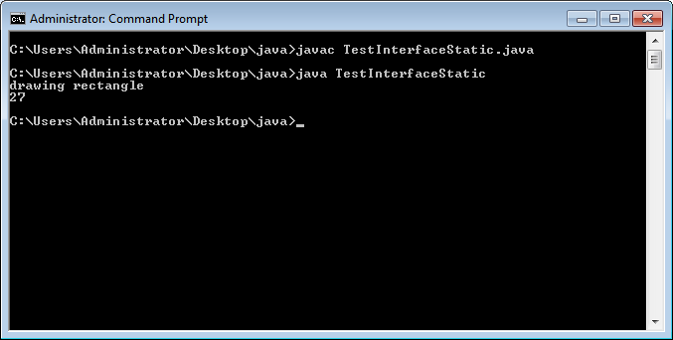
OOPS Abstratcion

Slide 90
Example
interface StaticInterface{
static void print(String str){
System.out.println("Static method of interface:"+str);
}
}
class Demo implements StaticInterface{
public static void main(String[] args){
StaticInterface.print("Java 8")
}
}
OOPS Abstratcion

Slide 91
Abstract class | Interface
1) Abstract class can have abstract and non-abstractmethods. | Interface can have only abstract methods. Since Java 8, it can have default and static methods also.
2) Abstract class doesn't support multiple inheritance. | Interface supports multiple inheritance.
3) Abstract class can have final, non-final, static and non-static variables. | Interface has only static and final variables.
4) Abstract class can provide the implementation of interface. | Interface can't provide the implementation of abstract class.
5) The abstract keyword is used to declare abstract class. | The interface keyword is used to declare interface.
6) An abstract class can extend another Java class and implement multiple Java interfaces. | An interface can extend another Java interface only.
7) An abstract class can be extended using keyword "extends". | An interface can be implemented using keyword "implements".
8) A Java abstract class can have class members like private, protected, etc. | Members of a Java interface are public by default.
9)Example: public abstract class Shape{ public abstract void draw(); } | Example: public interface Drawable{ void draw(); }
OOPS Abstratcion

Slide 92
//Creating interface that has 4 methods
interface A{
void a();//bydefault, public and abstract
void b();
void c();
void d();
}
//Creating abstract class that provides the implementation of one method of A interface
abstract class B implements A{
public void c(){System.out.println("I am C");}
}
//Creating subclass of abstract class, now we need to provide the implementation of rest of the methods
class M extends B{
public void a(){System.out.println("I am a");}
public void b(){System.out.println("I am b");}
public void d(){System.out.println("I am d");}
}
//Creating a test class that calls the methods of A interface
class Test5{
public static void main(String args[]){
A a=new M();
a.a();
a.b();
a.c();
a.d();
}}
OOPS Abstratcion

Slide 93
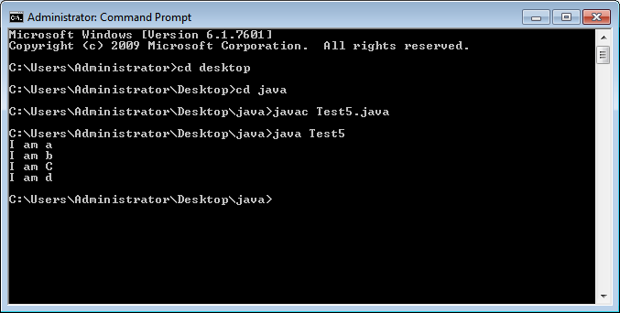
OOPS Abstratcion

Slide 94
loose coupling and tight coupling definition Loose coupling means reducing dependencies of a class that use different class directly. Tight coupling means classes and objects are dependent on one another.
https://www.interviewsansar.com/2018/03/24/loose-coupling-and-tight-coupling-in-java/
OOPS Abstratcion

Slide 95
Inner Class or nested inner class
OOPS Abstratcion

Slide 96
Example (nested inner class)
class Outer {
class Inner {
public void show() {
System.out.println("In a nested class method");
}
}
}
class Main {
public static void main(String[] args) {
Outer.Inner in = new Outer().new Inner();
in.show();
}
}
OOPS Abstratcion

Slide 97
Will it compile or not?
class Outer {
void outerMethod() {
System.out.println("inside outerMethod");
}
class Inner {
public static void main(String[] args){
System.out.println("inside inner class Method");
}
}
}
Error illegal static declaration in inner class Outer.Inner public static void main(String[] args) modifier ‘static’ is only allowed in constant variable declaration
OOPS Abstratcion

Slide 98
So we can’t have static method in a nested inner class
because an inner class is implicitly associated with an object of its outer class so it cannot define any static method for itself.
OOPS Abstratcion

Slide 99
Explore three other type of inner classes by your own
2) Method Local inner classes 3) Anonymous inner classes 4) Static nested classes
OOPS Abstratcion

Slide 100
2. Method Local inner classes
public class Outer {
private String x = "outer";
public void doStuff() {
class MyInner {
public void seeOuter() {
System.out.println("x is " + x);
}
}
MyInner i = new MyInner();
i.seeOuter();
}
public static void main(String[] args) {
Outer o = new Outer();
o.doStuff();
}}
x is outer
OOPS Abstratcion

Slide 101

OOPS Abstratcion

Slide 102
2. Method Local inner classes
public class Outer {
private static String x = “static outer";
public void doStuff() {
class MyInner {
public void seeOuter() {
System.out.println("x is " + x);
}
}
MyInner i = new MyInner();
i.seeOuter();
}
public static void main(String[] args) {
Outer o = new Outer();
o.doStuff();
}}
x is static outer
OOPS Abstratcion

Slide 103
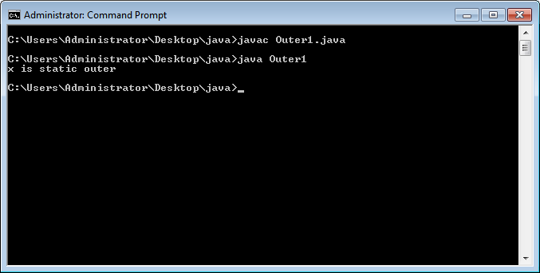
Polymorphism

Slide 104
3. Anonymous inner classes
A class that have no name is known as anonymous inner class in java. It should be used if you have to override method of class or interface.
Java Anonymous inner class can be created by two ways:
Class (may be abstract or concrete).
Interface
OOPS Abstratcion

Slide 105
It is an inner class without a name and for which only a single object is created.
Anonymous inner classes are useful in writing implementation classes for listener interfaces in graphics programming.
OOPS Abstratcion

Slide 106
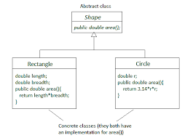
OOPS Abstratcion

Slide 107
Syntax
// Test can be interface,abstract/concrete class
Test t = new Test()
{
// data members and methods
public void test_method()
{
........ ........
}
};
Polymorphism

Slide 108
/* AnonymousClassDemo.java */
public class Ademo
{
public static void main(String[] args)
{
Dog dog = new Dog() {
public void someDog ()
{
System.out.println("Anonymous Dog");
}
}; // anonymous class body closes here
//dog contains an object of anonymous subclass of Dog.
dog.someDog();
}
}
class Dog
{
public void someDog()
{
System.out.println("Classic Dog");
}
}
OOPS Abstratcion

Slide 109
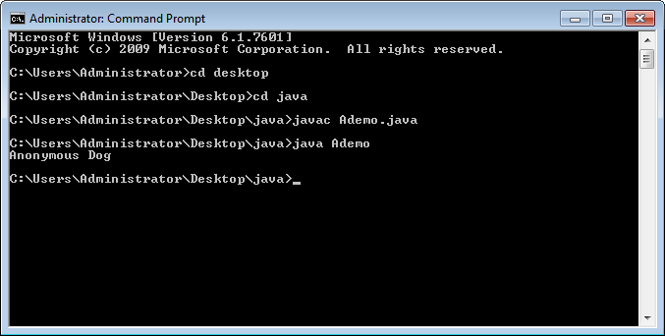
OOPS Abstratcion

Slide 110
Anonymous inner class example using abstract class
abstract class Person{
abstract void eat();
}
class TestAnonymousInner{
public static void main(String args[]){
Person p=new Person(){
void eat(){System.out.println("nice fruits");}
};
p.eat();
}
}
OOPS Abstratcion

Slide 111
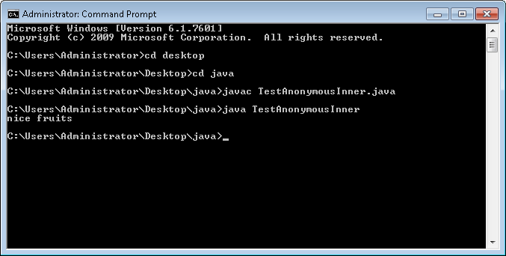
OOPS Abstratcion

Slide 112

OOPS Abstratcion

Slide 113

OOPS Abstratcion

Slide 114
How many class file will be generated after compilation?
Person.class
TestAnonymousInner$1.class
TestAnonymousInner.class
We can execute code using only TestAnonymousInner.class
OOPS Abstratcion

Slide 115
Internal working of given code
Person p=new Person(){
void eat(){System.out.println("nice fruits");}
};
A class is created but its name is decided by the compiler which extends the Person class and provides the implementation of the eat() method.
2. An object of Anonymous class is created that is referred by p reference variable of Person type.
OOPS Abstratcion

Slide 116
Internal class generated by the compiler
static class TestAnonymousInner$1 extends Person
{
TestAnonymousInner$1(){}
void eat()
{
System.out.println("nice fruits");
}
}
OOPS Abstratcion

Slide 117
Conclusion
Anonymous inner classes are inherited ones, and we always use a superclass reference variable to refer to an anonymous subclass object.
we can only call methods on an anonymous inner class object that are defined in the superclass.
Though, we can introduce new methods in anonymous inner class, but we cannot access them through the reference variable of superclass because superclass does not know anything about new methods or data members introduced in subclass.
OOPS Abstratcion

Slide 118
Java anonymous inner class example using interface
interface Eatable{
void eat();
}
class TestAnnonymousInner1{
public static void main(String args[]){
Eatable e=new Eatable(){
public void eat(){System.out.println("nice fruits");}
};
e.eat();
}
}
OOPS Abstratcion

Slide 119
Nested Interface
interface printable{
void print();
interface MessagePrintable{
void msg();
}
}
OOPS Abstratcion

Slide 120
Example
interface Showable{
void show();
interface Message{
void msg();
}
}
class TestNestedInterface implements Showable.Message{
public void msg(){
System.out.println("Hello nested interface");}
public static void main(String args[]){
Showable.Message message=new TestNestedInterface();
message.msg();
} }
OOPS Abstratcion

Slide 121
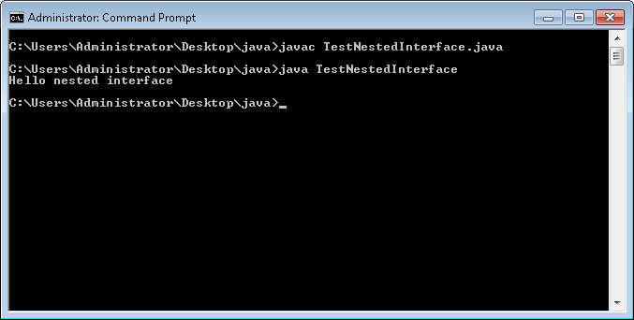
OOPS Abstratcion

Slide 122
How to call show() method in previous example?
OOPS Abstratcion

Slide 123
Solution
interface Showable{
void show();
interface Message{
void msg();
}
}
class TestNestedInterface implements Showable, Showable.Message{
public void msg(){
System.out.println("Hello nested interface");}
public void show(){
System.out.println("SHOW Hello nested interface");}
public static void main(String args[]){
Showable.Message message=new TestNestedInterface();
message.msg();
Showable m = new TestNestedInterface();
m.show();
} }
OOPS Abstratcion

Slide 124
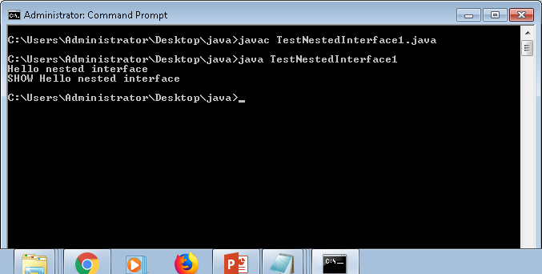
OOPS Abstratcion

Slide 125
Can we declared interface within the class?
YES
OOPS Abstratcion

Slide 126
Example
class A{
interface Message{
void msg();
}
}
class InterfaceWithinClass implements A.Message{
public void msg(){
System.out.println("Hello nested interface");}
public static void main(String args[]){
A.Message message=new InterfaceWithinClass();
message.msg();
} }
OOPS Abstratcion

Slide 127
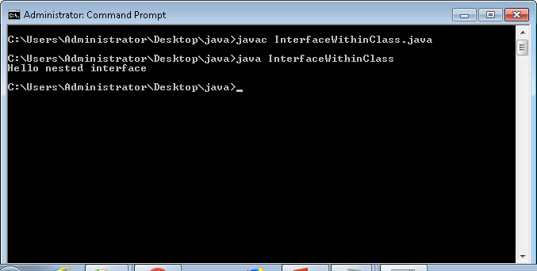
OOPS Abstratcion

Slide 128
Is there any problem in Interface?
OOPS Abstratcion

Slide 129
Example
Interface It1
{ void m1();
void m2();
void m3();
void m4();
void m5();
void m6();
void m7();
void m8();
void m9();
void m10();
}
Class X implements It1
{ void m1(){}
void m2(){}
void m3(){}
void m4(){}
}
OOPS Abstratcion

Slide 130
Solution
Adapter Class
OOPS Abstratcion

Slide 131
Example
Interface It1
{ void m1();
void m2();
void m3();
void m4();
void m5();
void m6();
void m7();
void m8();
void m9();
void m10();
}
Class X implements It1
{ void m1(){}
void m2(){}
void m3(){}
void m4(){}
void m5(){}
void m6(){}
void m7(){}
void m8(){}
void m9(){}
void m10(){}
}
Class Test extends X{
}
OOPS Abstratcion

Slide 132
Can Interface have constructor?
NO
OOPS Abstratcion

Slide 133
Example
public interface sample
{
int a=10;
sample(){
}
}
Error description: Interfaces cannot have constructors.
OOPS Abstratcion

Slide 134
Reason
Interfaces in Java don’t have constructor because all data members in interfaces are public static final by default, they are constants(assign values at the time of declaration) .There are no data members in interfaces to initialize them through constructor.
interface doesn't allow us to create constructor.
OOPS Abstratcion

Slide 135
Any Question???

Slide 136
Q-1 What is the output for the below code ?
public interface InfA {
protected String getName();
}
public class Test implements InfA{
public String getName(){
return "test-name";
}
public static void main (String[] args){
Test t = new Test();
System.out.println(t.getName());
}
}
Options are
A. test-name
B. Compilation fails due to an error on lines 2
C. Compilation fails due to an error on lines 1
D. Compilation succeed but Runtime Exception
B. Compilation fails due to an error on lines 2
OOPS Abstratcion

Slide 137
Q.02
class A
{
A(String s){ }
A(){ }
}
class B extends A{
B(){ }
B(String s){
super(s);
}
void test()
{
7. // insert code here
}
}
Which of the below code can be insert at line 7 to make clean compilation ?
A. A a = new B();
B. A a = new B(5);
C. A a = new A(String s);
D. All of the above
E. None of these
A. A a = new B();
OOPS Abstratcion

Slide 138
class Alpha { String getType() { return "alpha"; } } class Beta extends Alpha { String getType() { return "beta"; } } public class Gamma extends Beta {
String getType() { return "gamma"; } public static void main(String[] args) { Gamma g1 = new Alpha(); Gamma g2 = new Beta(); System.out.println(g1.getType() + " “+ g2.getType()); } }
Q.03
What is the result?
A) alpha beta
B) beta beta
C) gamma gamma
D) Compilation fails.
D) Compilation fails
OOPS Abstratcion

